Slide 1
Doubly Linked List
Name
Department Course Number Section Time Location
DATE
By: C125 Mayank Sejpal
C126 Rushabh Shah
C127 Udit Suvarna

Slide 2
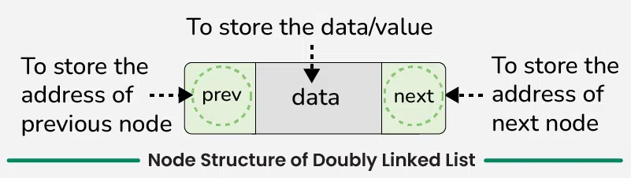
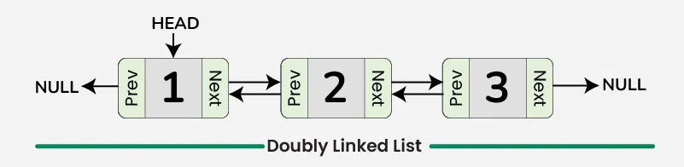
Introduction
Name
Department Course Number Section Time Location
DATE
A doubly linked list is a linked data structure that consists of a set of sequentially linked records called nodes.
A doubly linked list is represented using nodes that have three fields:
Data
A pointer to the next node (next)
A pointer to the previous node (prev)

Slide 3
Why is it Better?
Name
Department Course Number Section Time Location
DATE
Doubly linked list is better than other data structures in certain scenarios:
Compared to arrays, it has faster insertion & deletion and also dynamic memory allocation.
Compared to singly linked list, it allows bidirectional traversal.
Compared to trees, it has faster insertion & deletion.

Slide 4
Pros and Cons
Name
Department Course Number Section Time Location
DATE
Pros
Cons
Bidirectional traversal
Easy insertion and deletion of nodes
Implementation of stack and queue
More complex than singly linked list
Larger memory overhead

Slide 5
Real Life: Browser History
Name
Department Course Number Section Time Location
DATE
Doubly linked lists are used by web browsers for managing forward and backward navigation.
Each visited page is stored as a node in the list.
The previous pointer links to the last visited page, and the next pointer links to the next page.
Clicking "Back" moves to the previous node.
Clicking "Forward" moves to the next node.

Slide 6
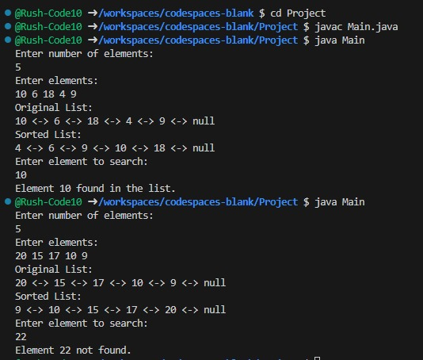
Code Implementation
Name
Department Course Number Section Time Location
DATE

